Slide 1
WellSpring☘
Your Path to Wellness Starts Here

Slide 2
TABLE OF CONTENTS
ER Diagram
Home
Services
About
Reviews
Contact Info
Patient Login
Patient Registration
Patient Dashboard
Appointment
Doctor Login
Doctor Registration
Doctor Dashboard
IOS Mobile App

Slide 3
ER Diagram

Slide 4
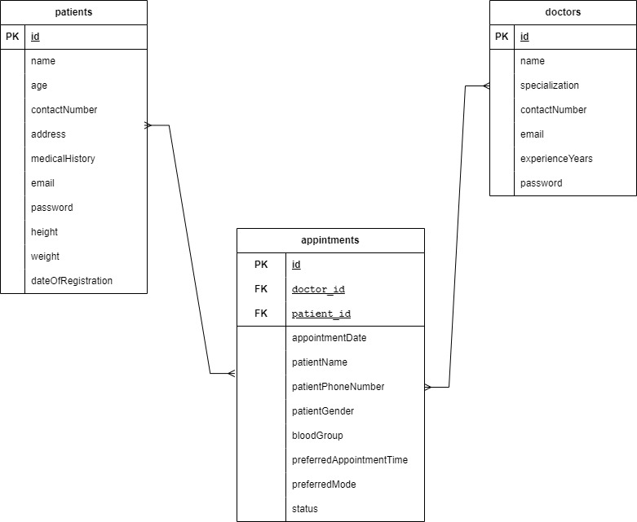
Doctor ↔ Appointment(one-to-many)
Patient ↔ Appointment(one-to-many)

Slide 5
WEB APPLICATION

Slide 6

HomePage

Slide 7
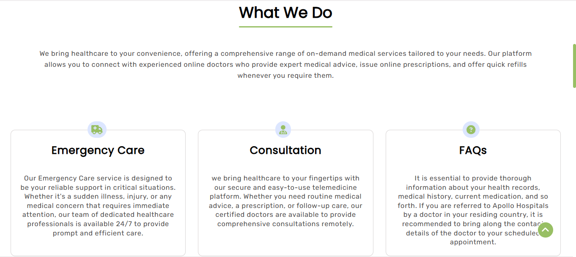
Services:

Slide 8

About

Slide 9
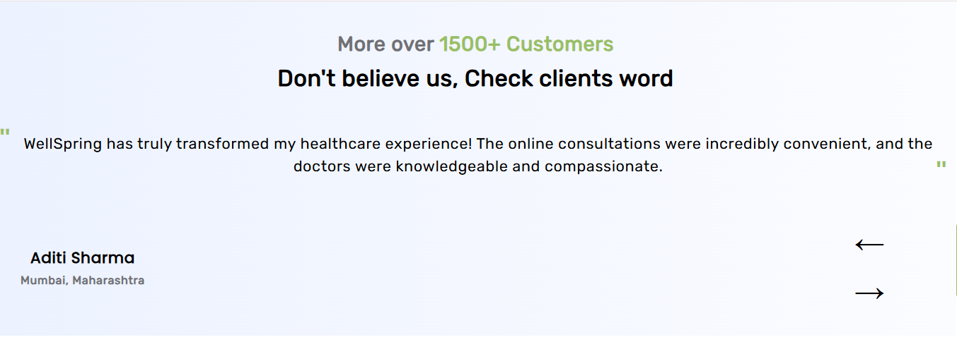
Reviews

Slide 10

Doctors

Slide 11
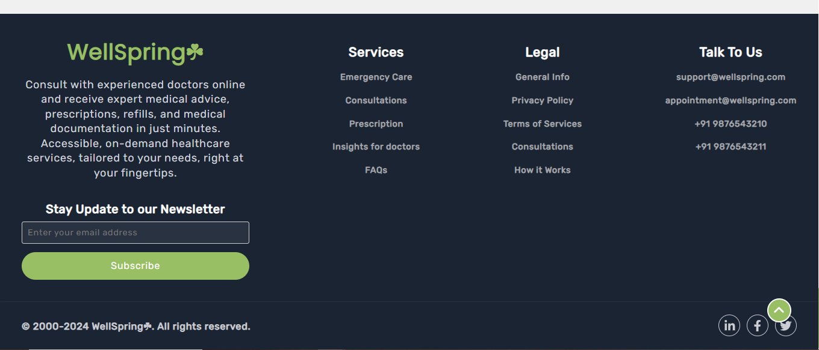
ContactInfo

Slide 12
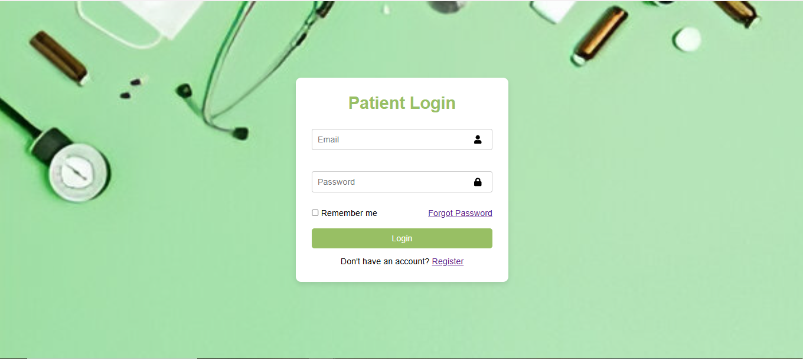
PatientLogin

Slide 13
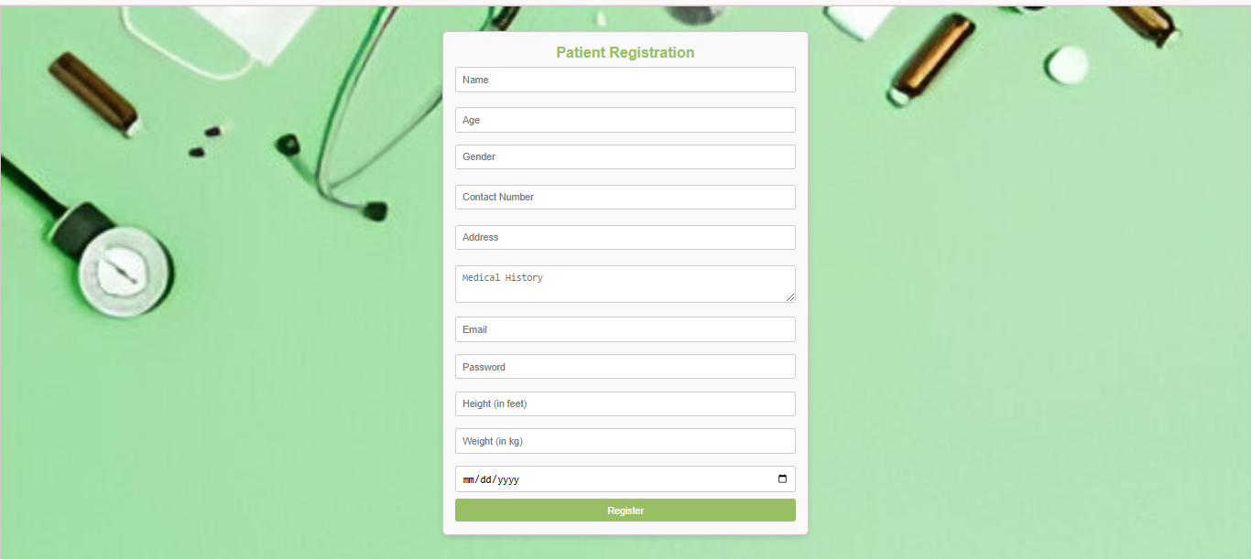
PatientRegister

Slide 14

PatientDashboard-1

Slide 15
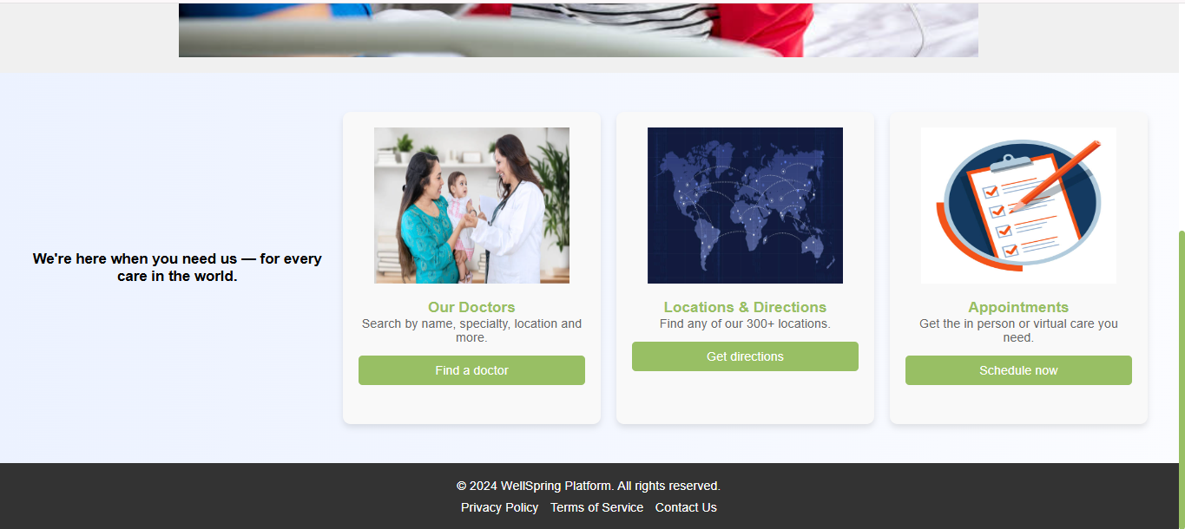
PatientDashboard-2

Slide 16
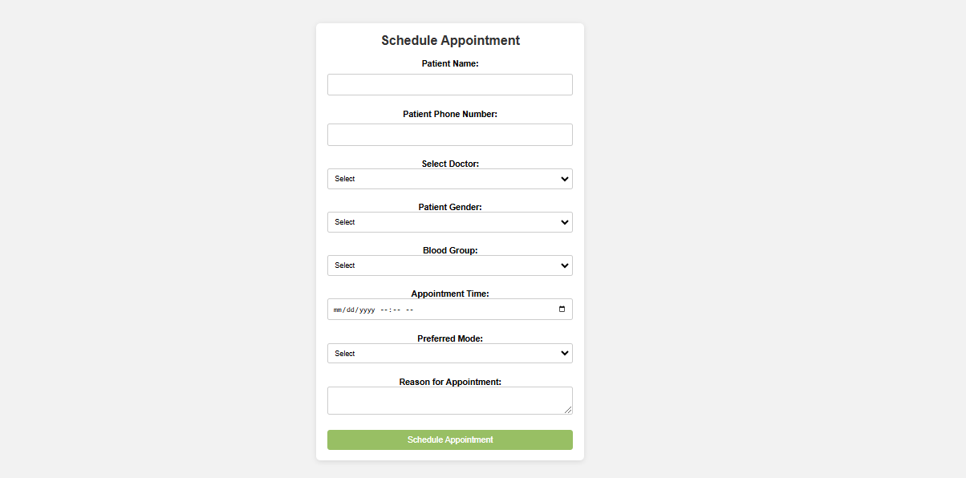
AppointmentForm:

Slide 17
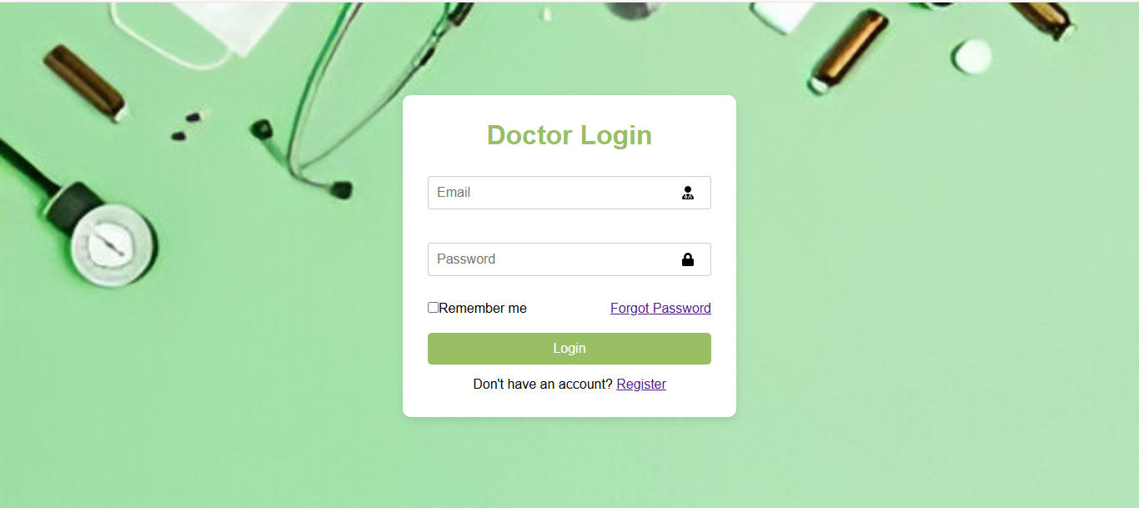
DoctorLogin

Slide 18
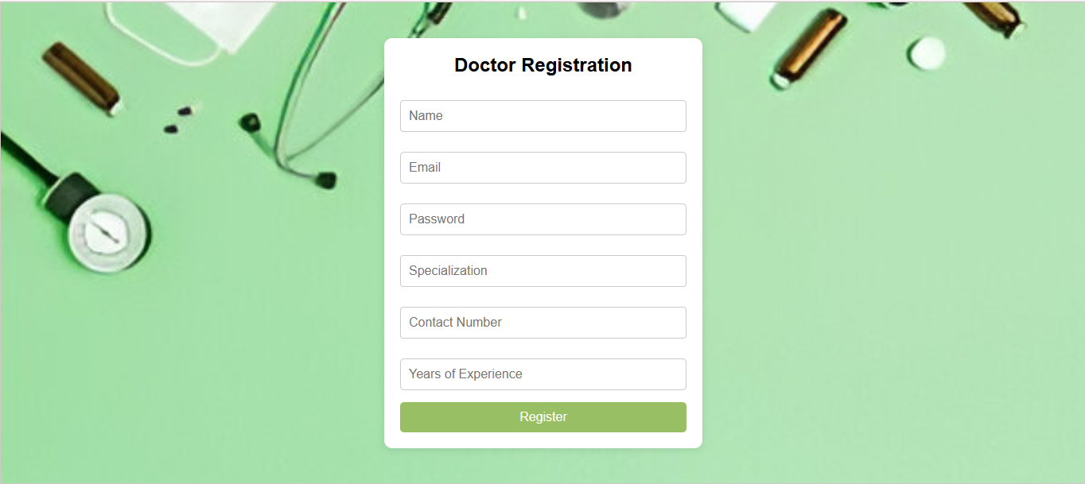
DoctorRegister:

Slide 19
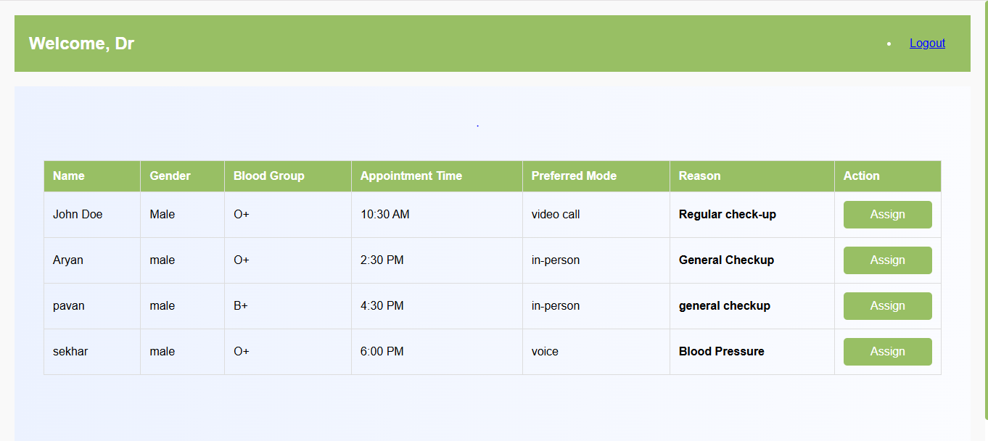
DoctorDashboard

Slide 20
IOS
Mobile Application

Slide 21
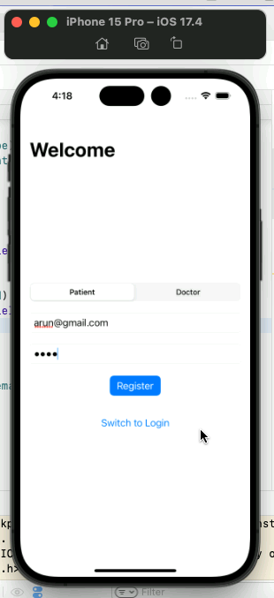
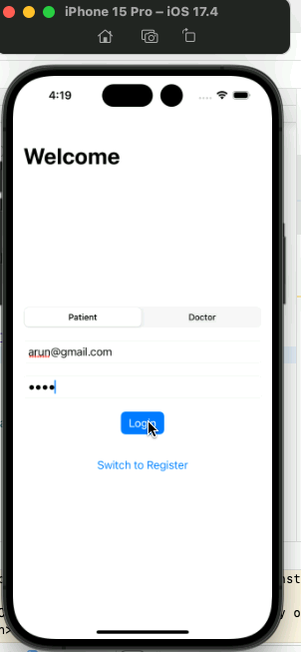
Patient Login & register

Slide 22
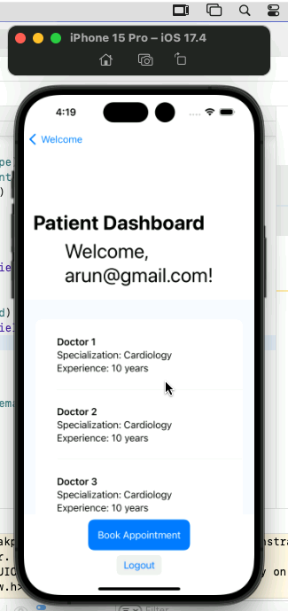
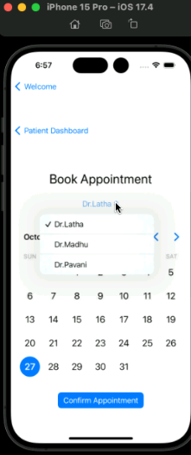
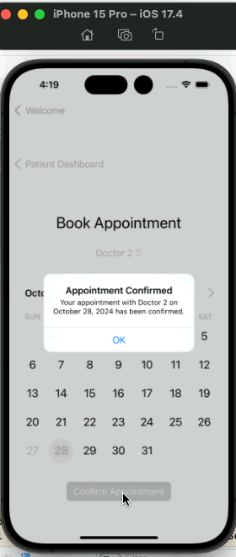
Patient Dashboard

Slide 23
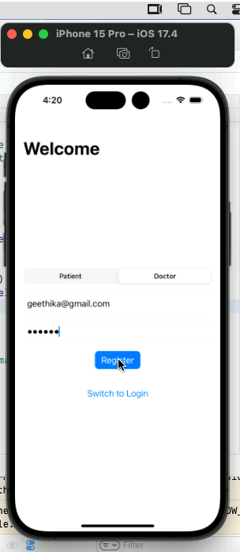
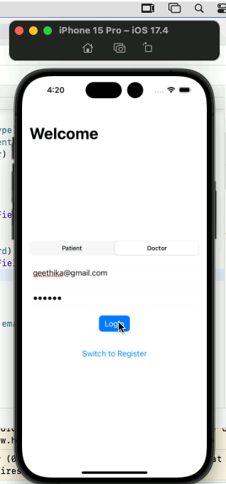
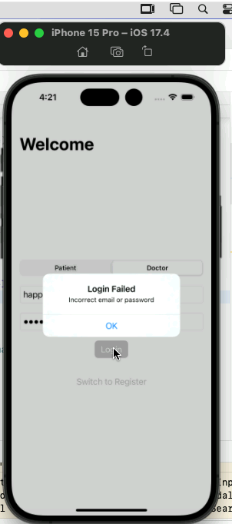
Doctor Login

Slide 24
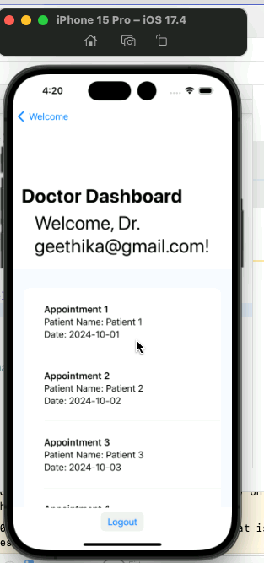
Doctor Dashboard

Slide 25
THANK YOU!

